Slide 1
SWAT+ Paddy Module
Paddy module extends wetland processes
HRU scale
Surface ponding (water, sediment, mineral N/P, organic N/P)
Weir discharge control (rectangular weir equation)
Continuous irrigation based on target/threshold depth
Irrigation methods
Manual operation based on management schedule
Automatic irrigation based on decision tables
(Automatic) Water allocation based on irrigation demand
Seeding or transplanting
Puddling
Reduces Ksat of the top layer
Redistribute sediment and nutrient between plough depth and standing water
Soil permeability setting

Slide 2
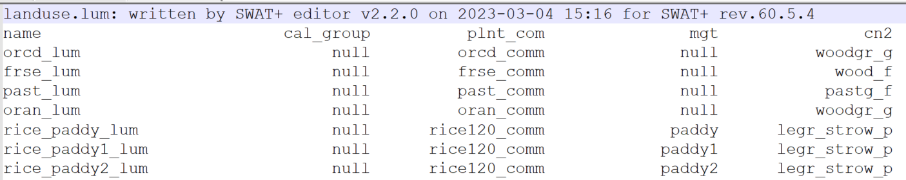
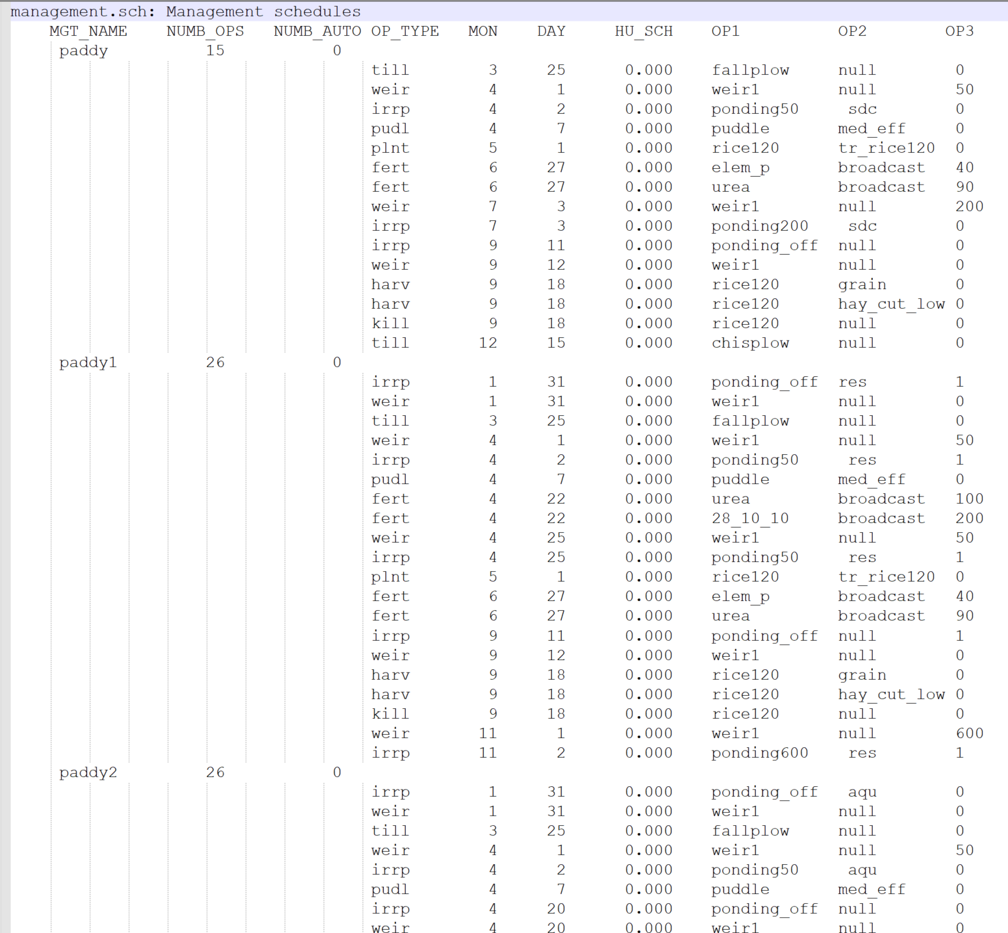
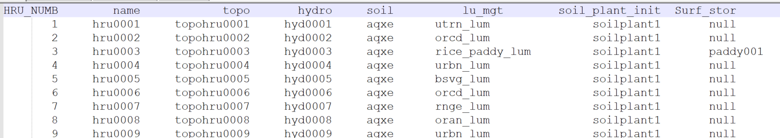
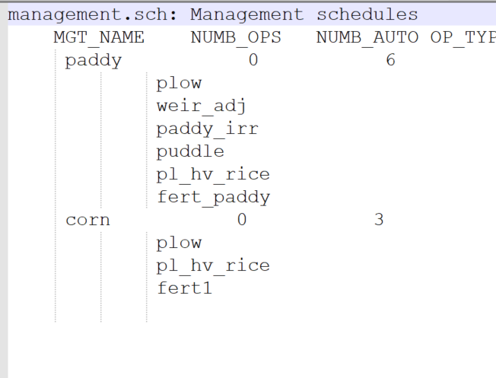
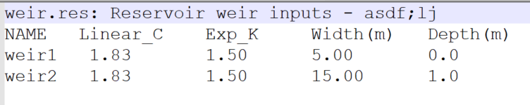
Setting up Management Schedules
Management.sch
Land management setting
Hru-data.hru
Paddy/wetland setting
Wetland.wet
*New columns

Slide 3
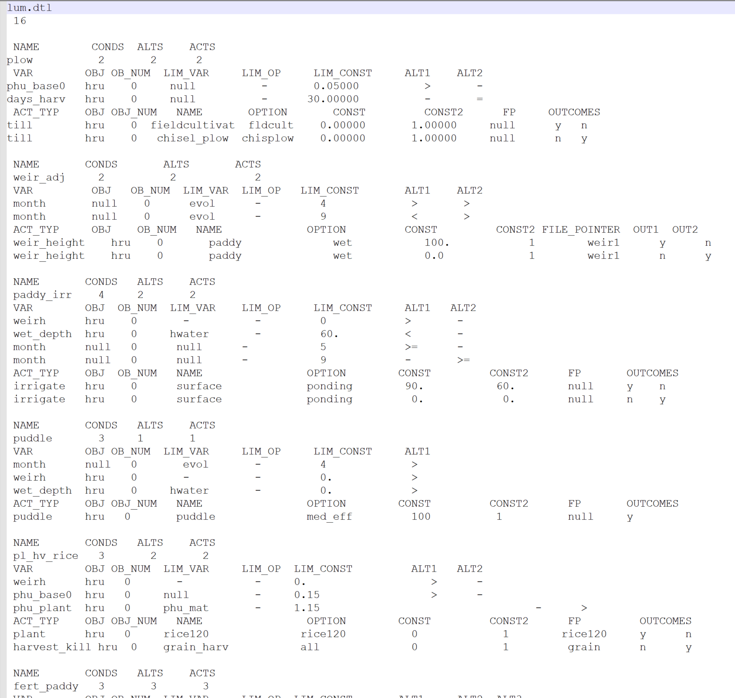
Automatic Operations using Decision Tables
Conditions
Actions
New conditions
Total numbers:
- 50 conditions
- 38 actions
wet_depth !paddy water depth, mm
weirh !paddy weir height, mm
vol_wet !water volume - stored on an hru m3
select case (d_tbl%cond(ic)%lim_var)
case ("pvol") !prinicpal storage volume
case ("evol") !emergency storage volume
New Actions
irrigate Required for paddy irrigation: d_tbl%act(iac)%name=='ponding’
Irr_demand Required for paddy irrigation: d_tbl%act(iac)%name=='ponding’
Puddle !puddle
Impound_on !turn on hru impounded water - rice paddy or wetland
Impound_off !remove impoundment
weir_height !adjust weir height – rice paddy/wetland
Required: d_tbl%act(iac)%option == "wet"

Slide 4
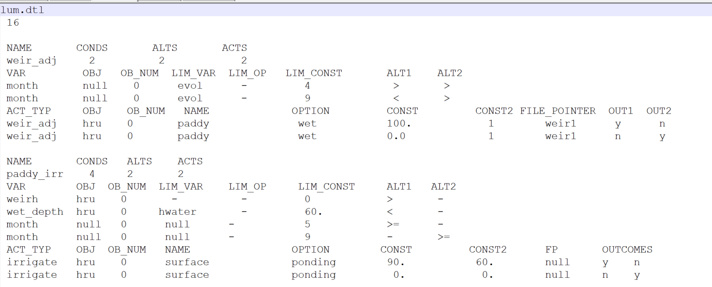
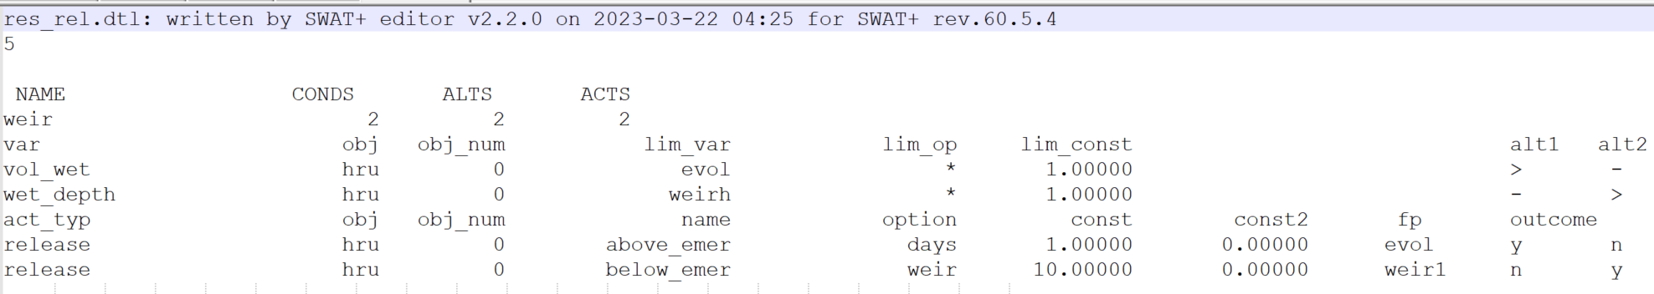
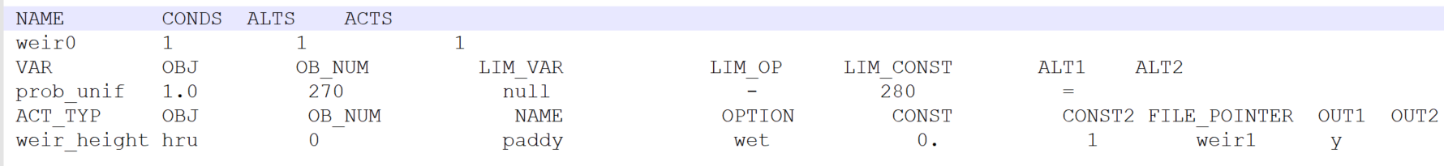
Setting Conditions for Paddy Operation
weirh
OBJ = hru OB_NUM = 0 !current HRU calling the current decision table OB_NUM > 0 !a value greater than zero means a specific HRU the condition applies to. LIM_VAR, LIM_OP !not used LIM_CONST !current weir height of the HRU in mm Example: OB_NUM=0; LIM_CONST=100; ALT1=“>” the condition is met if the weir height (mm) of the current HRU is greater
vol_wet
OBJ, OB_NUM are used the same way as in “weirh” LIM_VAR !pvol/evol/null to set a reference storage volume LIM_OP !operator. Null if not used. * : multiply LIM_CONST to LIM_VAR / : divide LIM_VAR by LIM_CONST + : add LIM_CONST to LIM_VAR - : subtract LIM_CONST from LIM_VAR LIM_CONST !a value to be used alongside the operator. Default is 1.0. Example: LIM_VAR=EVOL; LIM_OP=*; LIM_CONST=0.8; ALT1=“>” the condition is met if the wetland ponding water volume (m³) is greater than 0.8*evol
wet_depth
OBJ, OB_NUM are used the same way as in “weirh” LIM_VAR !two options available hwater: ponding depth (mm) weir_hgt: weir height (mm) LIM_CONST !weir height or ponding depth Example: OB_NUM=0; LIM_VAR=“hwater”; LIM_CONST=0; ALT1 the condition is met if ponding depth of the current HRU is greater than zero
Prob_unif
OBJ_NUM !first Julian date of the time window the uniform probability applies LIM_CONST !the last Julian date that the uniform probability applies LIM_VAR !pvol/evol/null to set a reference storage volume LIM_OP !operator. Null if not used. ALT = “=“ !the condition is met if the current date is same as the randomly selected date during the time window

Slide 5
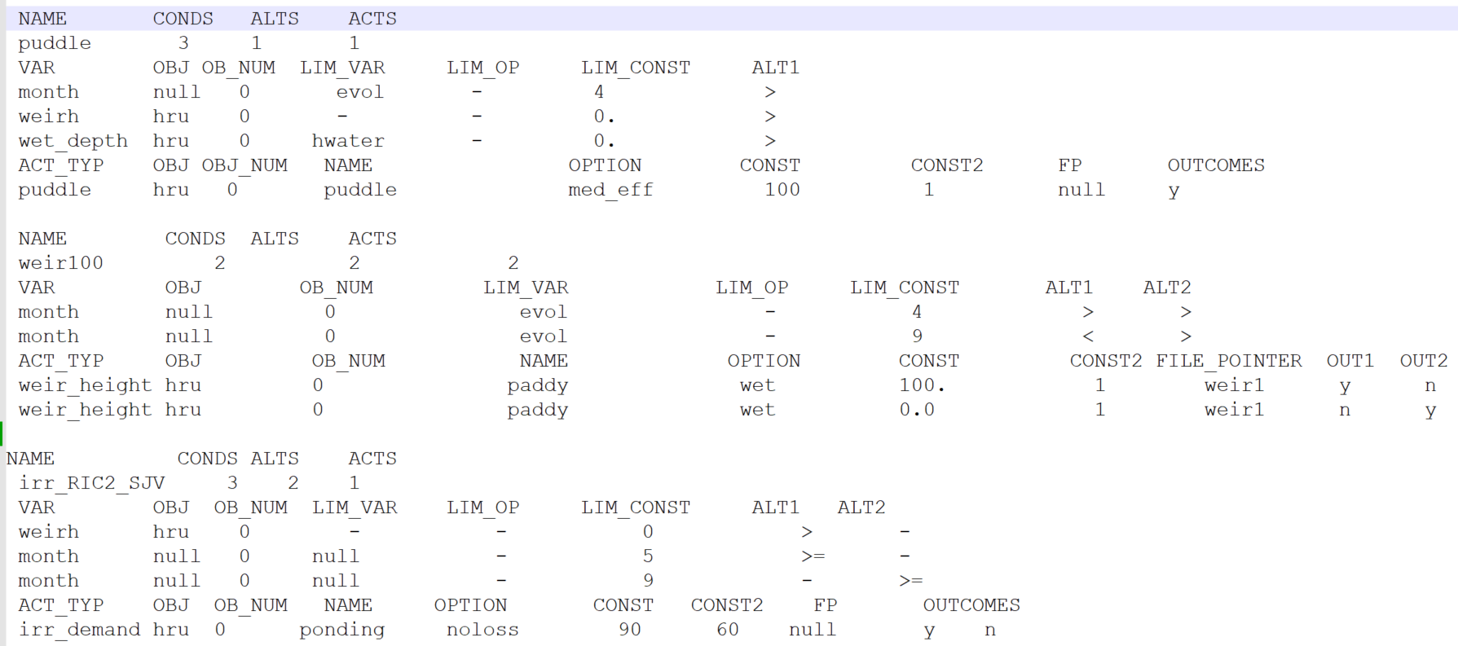
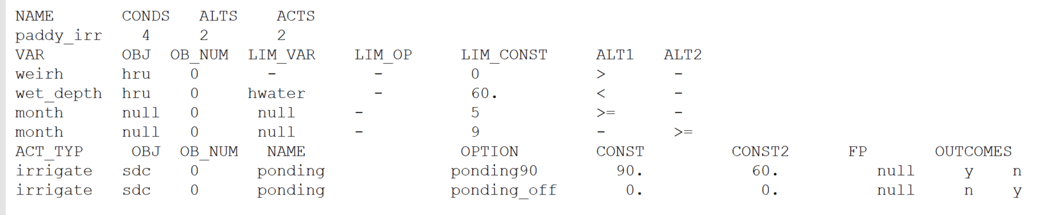
Setting Actions for Paddy Operation
Puddle
Description: apply puddling operation (reduces topsoil Ksat and increase sediment conc) OBJ = hru OB_NUM = 0 !current HRU calling the current decision table OPTION !name of the puddle operation in puddle.ops LIM_CONST !current weir height of the HRU in mm
Weir_height
Description: adjust the discharge weir height OBJ = hru OB_NUM = 0 !current HRU calling the current decision table OB_NUM > 0 !a value greater than zero means a specific HRU the condition applies to. OPTION = ‘wet’ to apply paddy/wetland weir control as opposed to reservoir control CONST !new weir height in mm PVOL is updated based on the new weir height EVOL is updated as 120% of pvol
Irrigate
Description: apply irrigation OBJ is the source of irrigation: HRU, CHA, SDC, RES, AQU OB_NUM = 0 !current HRU or the ID of the OBJ the current HRU is connected OB_NUM > 0 !object ID of the OBJ NAME = ‘ponding’ for paddy continuous irrigation OPTION !name of the irrigation method in irr.ops CONST !target water depth in mm CONST2 !threshold water depth in mm
Irr_demand
Description: estimates irrigation demands for water allocation OBJ = HRU OB_NUM = 0 !current HRU NAME = ‘ponding’ for paddy continuous irrigation OPTION !name of the irrigation method in irr.ops CONST !target water depth in mm CONST2 !threshold water depth in mm

Slide 6
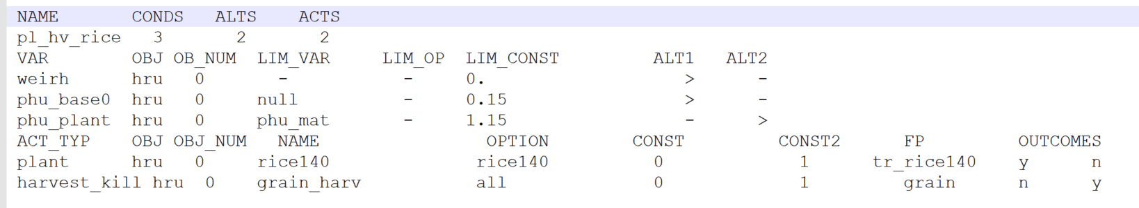
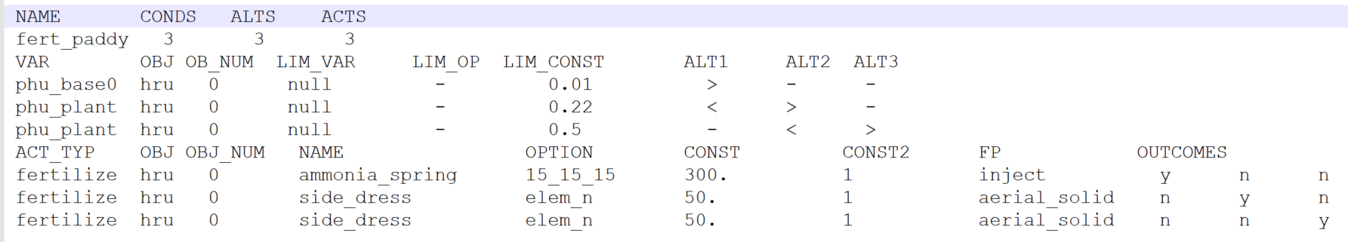
Setting Actions for Paddy Operation
Plant
Description: apply puddling operation (reduces topsoil Ksat and increase sediment conc) OBJ = hru OB_NUM = 0 !current HRU calling the current decision table OPTION !name of the crop being planted in plants.plt FP !”Null” for seed planting FP !name of transplanting operation in transplant.plt
Fertilize
Description: apply fertilizer. Fertilizer is applied to standing water if surface ponding water exists. OBJ = hru OB_NUM = 0 !current HRU calling the current decision table OB_NUM > 0 !a value greater than zero means a specific HRU the condition applies to. OPTION = !name of the fertilizer applied from fertilizer.frt CONST !fertilizer application rate in kg/ha CONST2 !number of applications to repeat if the condition is met FP !name of the application type to assign from chem_app.ops
Impound_on/Impound_off
Description: turn on or off wetland/paddy impoundment for HRU OBJ = HRU OB_NUM = 0 !current HRU FP !name of wetland/paddy type to assign to the HRU from wetland.wet
Harvest_kill
Description: harvest and kill the crop in the HRU OBJ = HRU OB_NUM = 0 !current HRU NAME !select a type in harv.ops OPTION !input “all” to kill all crops or a crop name to kill it

Slide 7
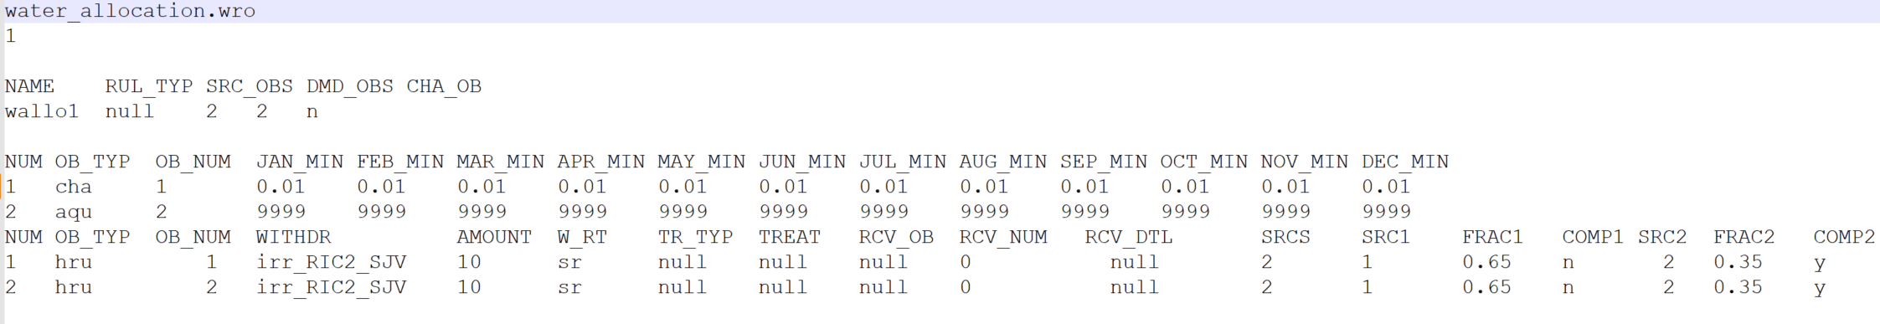
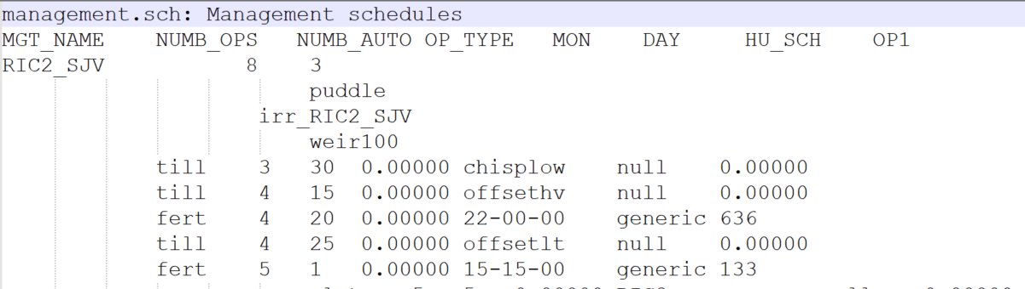
Setting Water Allocation for water distribution
Water_allocation.wro
Lum.dtl
Example water allocation setting
Two sources (Cha #1 and Aqu #2) available for water allocation Two receiving HRUs (#1 and #2) based on the irr_demand in “irr_RIC2_SJV” AMOUNT and W_RT are not used Water is allocated from the Cha#1 for 65% of the irrigation demand, and then 35% from the Aqu#2. If irrigation demand is not met due to limited water availability in the channel Aqu#2 is used as a compensating irrigation source
Management.sch

Slide 8
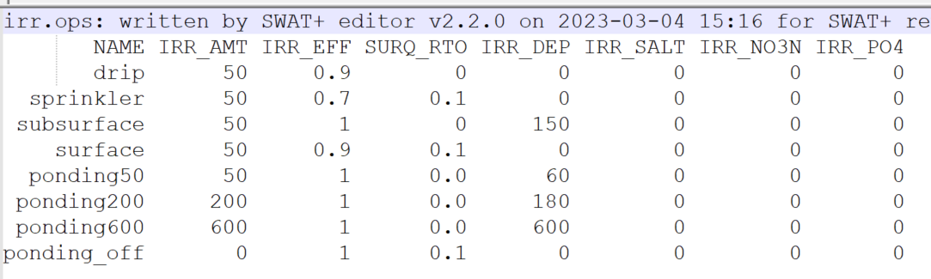
Manual Operations for Paddy Management
Management.sch
OP Name Description
weir !change weir height
!OP1 – weir name in weir.res
!OP3 – new weir height for overflow, mm
irrp !change paddy irrigation
!OP1 – irrigation type name in irr.ops
!OP2 – irrigation source (cha/sdc/res/aqu/null)
!OP3 – object ID of the irrigation source (0 for nearby one)
pudl !puddling operation
!OP2 – Puddle type name in puddle.ops
Plnt !planting (or transplanting)
!OP1 – plant name in plants.plt
!OP2 – transplanting type name in transplant.plt (OP3=1)
!OP3 – 0 (seeding) or 1 (transplanting)
Irr.ops
Puddle.ops

Slide 9
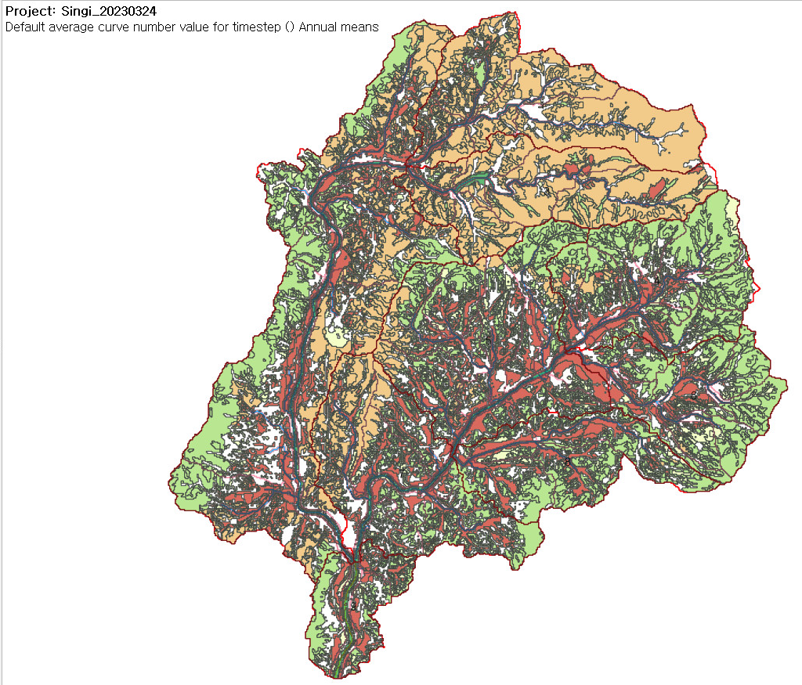
The Imsil watershed, South Korea
Watershed area is 161 km2
Rice paddies claim 20% of watershed
Rice is transplanted in late May and harvested in early October
Ponding period mid-May to early September
Water is irrigated from local streams
Model performance on channel flow at the watershed outlet (2013-2021) with 3-year warm-up (2010-2012)
PBIAS | 19.30
N&S efficiency | 0.89
RSR | 0.33
R2 | 0.87

